Slide 1
CST 499 Final Project
Chris Wintz
University of Arizona Global Campus
CST 499 Capstone for Computer Software Technology
Instructor: Joseph Rangitsch
June 13, 2024
Notes:
Hi everyone, I am Chris Wintz, and I will be sharing the main takeaways from my University of Arizona Global Campus Software Engineering course today. Now let's explore the key takeaways and real-world experience I had from this training.

Slide 2
Introduction
Welcome to my presentation on the most important lessons I learned at the University of Arizona Global Campus Software Engineering course. Over the last few weeks, I have learned a lot and obtained practical experience in various software development-related areas. An outline of the essential elements and abilities I have acquired during the course—such as requirements specification, UML design, web development, database management, and PHP programming—will be given in this presentation. You will have a thorough grasp of the ideas and methods I have learned by the end of this presentation, which is crucial for a fruitful career in software engineering.
Notes:
Greetings and welcome to my presentation on the most important things i learned in the Software Engineering course. I have learned a lot about software development during the last few weeks, gaining experience in database management, web development, UML design, requirements specification, and PHP programming. An overview of these vital knowledge and abilities, which are necessary for a prosperous career in software engineering, will be given in this presentation.

Slide 3
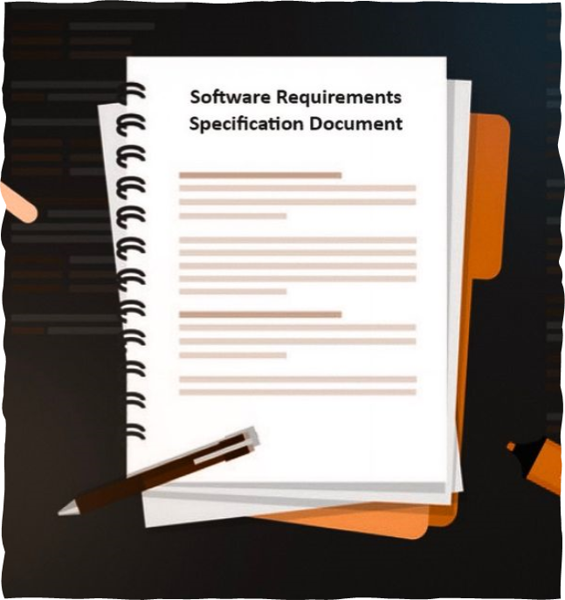
Key Learnings from the SRS Document
The Software Requirements Specification (SRS) document is crucial in the software development lifecycle. According to Ali et al. (2018), the software industry is experiencing significant growth, with software products serving as its foundation. When software companies develop these products, they must design them according to the customers' specifications. These requirements are documented in a template known as the Software Requirements Specification (SRS) (p.1). It keeps expectations in line and avoids misunderstandings by guaranteeing that all parties involved have a common knowledge of the goals and performance standards of the software. Functional needs, such as user authentication; non-functional requirements, such as security and performance; and limitations and presumptions, such as OS compatibility, are important. Detailed stakeholder conversations, methodical documenting, and requirement validation were all necessary in developing the SRS, underscoring the significance of careful analysis and accurate documentation for accomplishing software development goals.
Notes:
In the software development lifecycle, the Software Requirements Specification, or SRS document, is essential. It helps to avoid misunderstandings by guaranteeing that all parties involved are aware of the software's objectives and performance requirements. Functional needs such as user authentication, non-functional requirements like security and performance, and limitations such as OS compatibility are all included in the SRS. Detailed stakeholder talks, methodical documentation, and requirement validation were all involved in developing the SRS, underscoring the significance of careful analysis and accurate documentation.

Slide 4
Showcase UML Design Model
Effective design and communication of the system architecture were achieved using multiple UML diagrams. The use case diagram visualizes key user actions, such as scheduling classes and logging in. An overview of the classes, properties, and relationships inside the system is provided by the Class Diagram. All actions, including user authentication, are captured in the Sequence Diagram. To give clear requirements, improve stakeholder communication, provide comprehensive implementation blueprints, and detect possible design flaws early on, these diagrams are essential to the software development process. Effective and transparent system design is necessary for a project's development, and this systematic approach ensures it.
Notes:
The UML design model comes next. The system architecture was effectively designed and communicated through the use of many UML diagrams. Important user actions, such as scheduling classes and logging in, are visualized in the use case diagram. The classes, attributes, and relationships within the system are depicted in the class diagram. Actions like user authentication are captured in the Sequence Diagram. Clear requirements, enhanced stakeholder communication, thorough implementation plans, and early detection of potential design defects are all made possible by these diagrams.

Slide 5

Landing, Login, and Enrollment Pages
The enrollment, logging-in, and landing pages were made easily and intuitively. While the Login Page guarantees secure authentication with form validation and error handling, the Landing Page offers an overview and intuitive navigation. Class registration can be done dynamically using the enrollment page. These pages were created with HTML, CSS, and JavaScript, emphasizing usability, accessibility, and responsiveness. JavaScript enhances security measures like password encryption and adds interaction. This combination guarantees that the pages are easy to use, aesthetically pleasing, and functional.
Notes:
The landing, login, and enrollment pages are located here. These pages are meant to be easy to use and intuitive. The landing page offers a synopsis and simple navigation. Secure authentication is guaranteed by the Login Page, which also handles errors and validates forms. Class registration can be done dynamically using the enrollment page. These pages, which were created with HTML, CSS, and JavaScript, place a strong emphasis on responsiveness, accessibility, and usability. JavaScript improves security features like password encryption and interactivity.

Slide 6
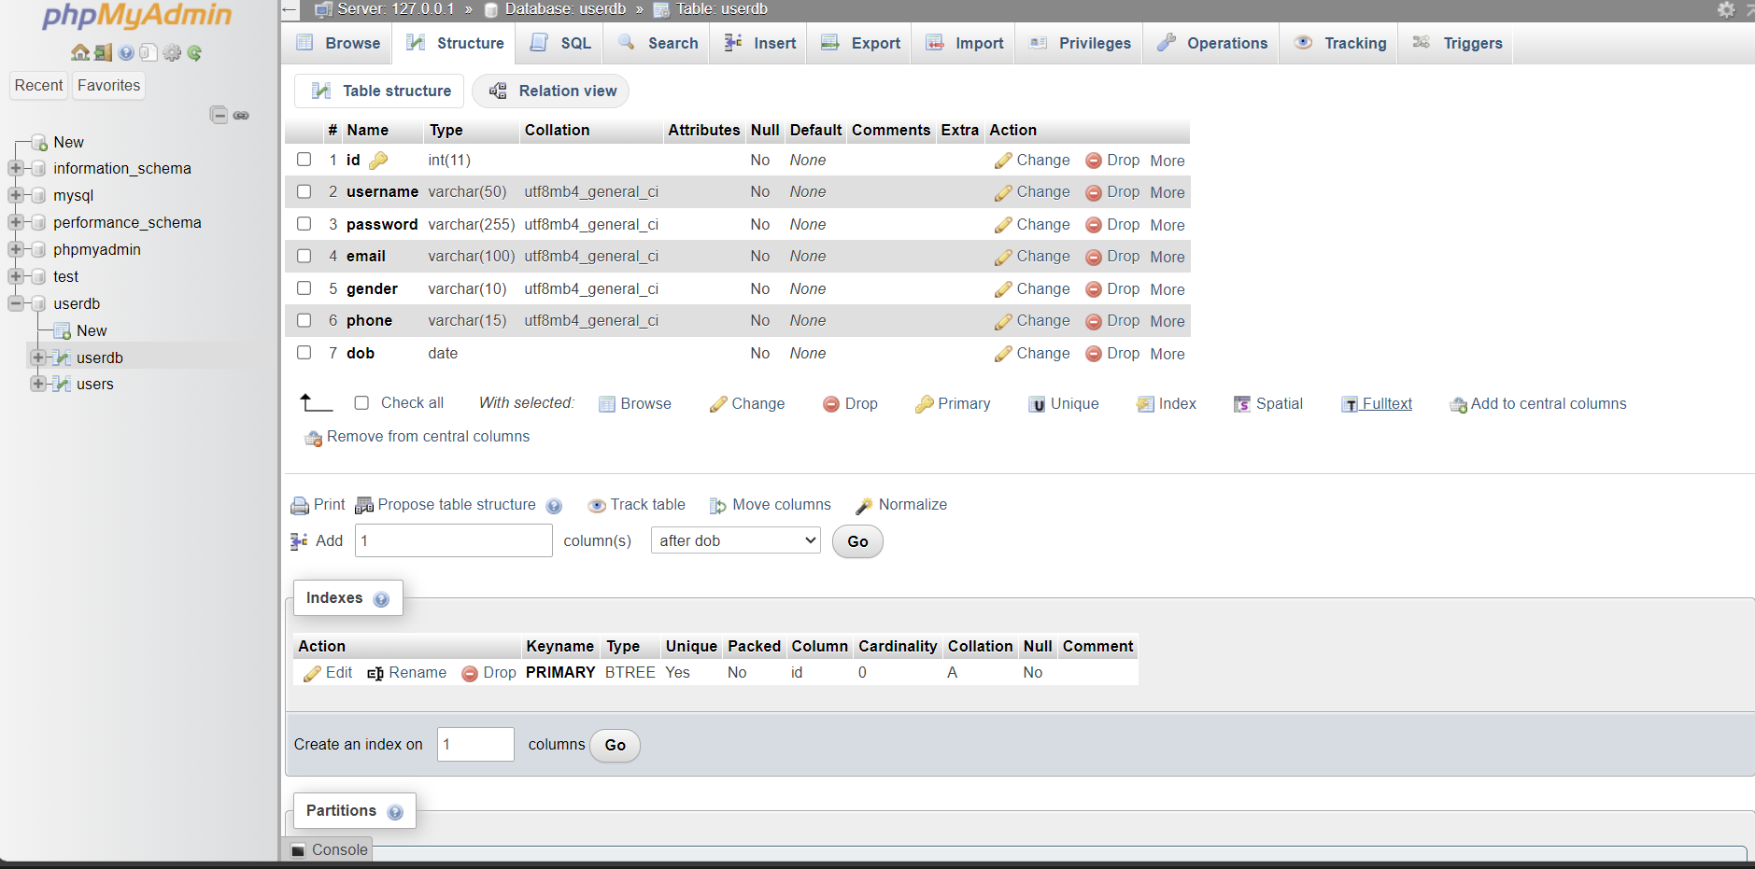
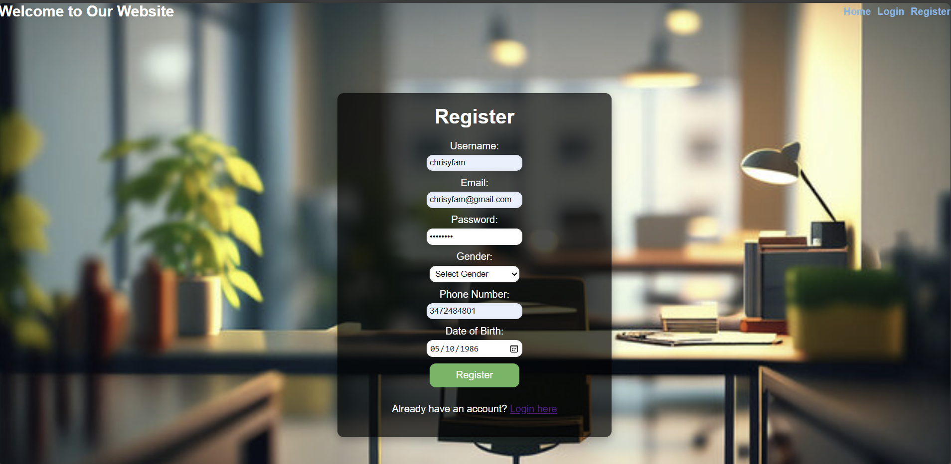
MySQL Database and Class Registration
The MySQL database design prioritized normalization to get rid of redundant information and guarantee data integrity. It featured tables for users, classes, enrollments, and associated entities. A web-based database application's development process begins with the creation of an interactive HTML page interface, as stated by Tsui et al. (2018). To create a dynamic user interface, an HTML document can have a variety of features, including frames, lists, tables, formatting tags, hyperlinks, and Cascading Style Sheets (CSS). Websites with several input fields can accept data entry and selections from users thanks to HTML forms (p. 162). Supporting the system's functionalities was this organized method of organizing and retrieving data. Referential integrity was preserved by foreign key constraints, while query efficiency was increased via indexes. Data reporting, automatic enrollment updates, conflict checks, and encrypted passwords and roles for user authentication were among the important features. Complex queries and business logic were handled via stored procedures, which guaranteed smooth operation and satisfied user needs.
Notes:
Tables for users, classes, enrollments, and associated entities were incorporated in the MySQL database design, which placed a strong emphasis on normalization to guarantee data integrity. This methodical technique made data handling more effective. Data reporting, class registration with automatic updates and conflict checks, and user authentication with encrypted passwords were among the important features. Complex queries and business logic were handled via stored procedures, which guaranteed efficient operation and satisfied user needs.

Slide 7

PHP Code Development
Key features including form processing, user authentication, session management, and MySQL database connection were the main priorities of the PHP code development for this project. Using encrypted passwords, PHP scripts validated user credentials and initiated sessions for authorized users. PHP supplied real-time feedback and dynamically updated the database for class enrollment. PHP and MySQL interacted extensively for retrieving, inserting, updating, and deleting data. Nixon (2012) emphasizes how PHP, MySQL, JavaScript, and CSS work remarkably well together to create dynamic web content. MySQL is in charge of data management, PHP handles the essential server-side functions, and CSS and JavaScript work together to guarantee a visually appealing website. Additionally, JavaScript can communicate with the server's PHP to carry out changes as needed (p. 10).To update enrollment figures and avoid conflicts, PHP, for example, evaluated login credentials and checked class availability. Performance was improved and database interactions were made safe and effective using prepared statements and parameterized queries to thwart SQL injection threats. A strong backend foundation was produced for the application by smoothly integrating MySQL and PHP.
Notes:
Important features including form processing, MySQL interaction, session management, and user authentication were the main emphasis of the PHP code development. PHP scripts handled sessions, verified user credentials, and gave real-time enrollment feedback. Data retrieval, insertion, updating, and deletion were among the operations that PHP and MySQL interacted on. SQL injection attacks were avoided and efficiency was improved by the use of prepared statements and parameterized queries, which guaranteed safe and effective database interactions.

Slide 8
Challenges and Solutions
Numerous obstacles that the project had to overcome were effectively resolved. Implementing password encryption and safe session management through careful study was necessary to provide secure user authentication. Adding indexes and improving SQL queries helped to maximize database performance for big datasets and intricate queries. Responsive design and cross-browser compatibility issues were fixed with thorough testing and contemporary web techniques. Specific problems, such as delayed class registration queries, were resolved by adding indexes and examining execution plans; real-time feedback from JavaScript and AJAX enhanced dynamic form validation. These fixes improved the efficiency and resilience of the system.
Notes:
The project had to overcome a number of obstacles, including making sure user login was secure, streamlining database operations, and guaranteeing cross-browser compatibility. Using contemporary web construction techniques, adding indexes, streamlining SQL queries, and putting password encryption and safe session management into place were some of the solutions. By examining execution plans and adding indexes, certain problems such as delayed class registration queries were fixed. Real-time JavaScript and AJAX feedback also helped to improve dynamic form validation.

Slide 9
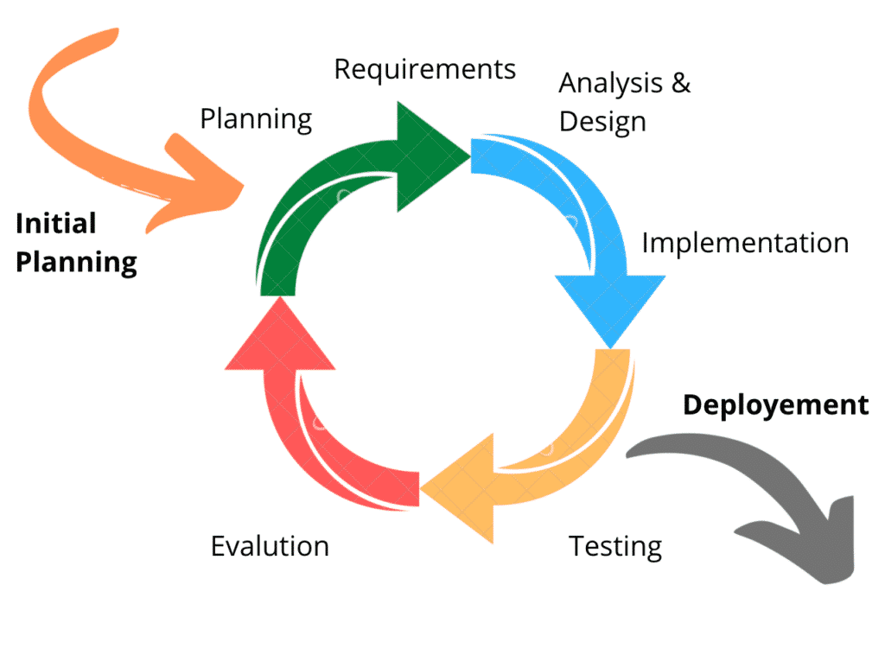
Application of Agile Methodology
Agile development concepts, prioritizing collaboration, adaptability, and incremental progress, were essential to the project's development. By dividing the project into sprints, holding frequent stand-up meetings, and consistently incorporating feedback, we used Agile approaches. This strategy enabled quickly identifying and fixing problems, keeping the project on schedule and meeting user expectations. Agile brought about several advantages, such as improved teamwork, greater flexibility in the face of change, and incremental delivery of functional components, allowing for extensive testing and quality control. Using Agile approaches taught me the value of flexibility and teamwork, greatly increasing the project's productivity and final result.
Notes:
Throughout the project, agile concepts including cooperation, flexibility, and incremental development were used. Agile approaches allowed for quick problem solving and kept the project on schedule by dividing the work into sprints, scheduling frequent stand-up meetings, and incorporating constant feedback. Benefits included increased flexibility, enhanced teamwork, and progressive delivery of functional components, which raised the general efficiency and caliber of the project.

Slide 10
Refernces
Ali, S. W., Ahmed, Q. A., & Shafi, I. (2018, February). Process to enhance the quality of software requirement specification document. In 2018 International Conference on Engineering and Emerging Technologies (ICEET) (pp. 1-7). IEEE.
Nixon, R. (2012). Learning PHP, MySQL, JavaScript, and CSS: A step-by-step guide to creating dynamic websites. " O'Reilly Media, Inc.".
Tsui, F., Karam, O., & Bernal, B. (2018). Essentials of software engineering (4th ed.). Jones & Bartlett Learning.

